Slide 1


SIMILARITY ANALYSIS OF SARS & MERS
Presenting by
B Sai Abhishek BL.EN.U4AIE21015
B Ruchith Balaji BL.EN.U4AIE21017
Chillakuru Hari BL.EN.U4AIE21038
Intelligence in Biological Systems-3

Slide 2
Contents:
Main Objective.
Introduction.
System Model
Implementation
Code
Conclusion

Slide 3
Main Objective:
To find the similarities between cov2,sars,mers
To analyze the genome sequencing of SARS and MERS.
Middle East Respiratory Syndrome (MERS).
Severe acute respiratory syndrome (SARS).

Slide 4
Introduction:
To implement this we need to have some basic knowledge of what is MERS,SARS.
What is MERS?
Middle East Respiratory Syndrome
First Reported – 2012 Saudi.
Severe Respiratory issues
Shortness of breath
Died

Slide 5
Introduction:
What is SARS ?
Severe acute respiratory syndrome (SARS)
Identified 2003 – China.
Airborne virus.
Transmission through:
Droplets of saliva
Cold
Influenza.

Slide 6
Symptoms:
MERS Symptoms:
Asymptomatic.
Mid respiratory symptoms
SARS Symptoms:
Incubation period 2-7 days
General fever ,chills and rigors.
Headache ,malaise.

Slide 7
Implementation:
Aromaticity
Importing
COV fasta
Converting to mRNA
Converting to Proteins
Protein Analysis
MW
Flexibility
Importing
MERS ,SARS
Checking
Similarity

Slide 8
Implementation:
Step-1: Import the COV2 genome fasta file.
Step-2: After importing convert the DNA sequence to Message RNA (mRNA)
Step-3: Later convert the mRNA sequence to proteins using the codon table.
Step-4: After converting the message RNA to proteins, find Aromaticity, Molecular weight, Flexibility.

Slide 9
Implementation:
AROMATICITY.
MOLECULAR WEIGHT.
FLEXIBILITY.
Step-5: Then Import MERS and SARS fasta file to check similarity between them.
Step-6: After that conclude.

Slide 10
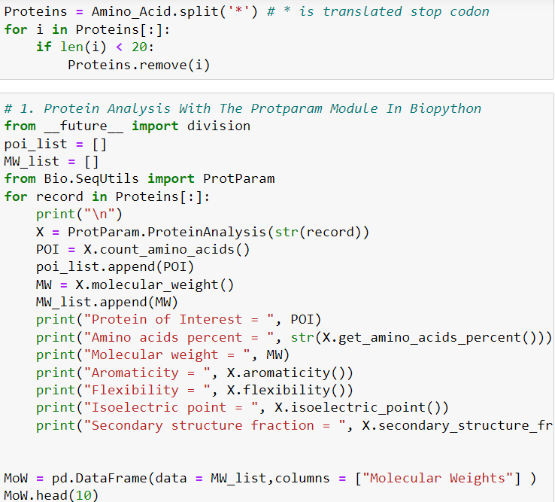
Code

Slide 11
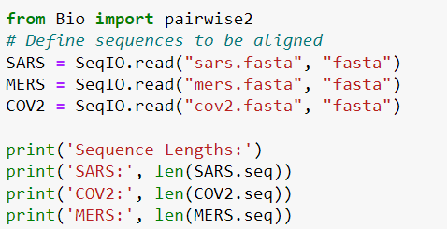
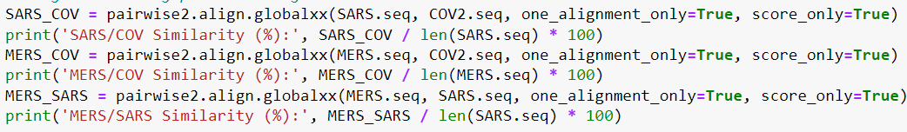
Code

Slide 12
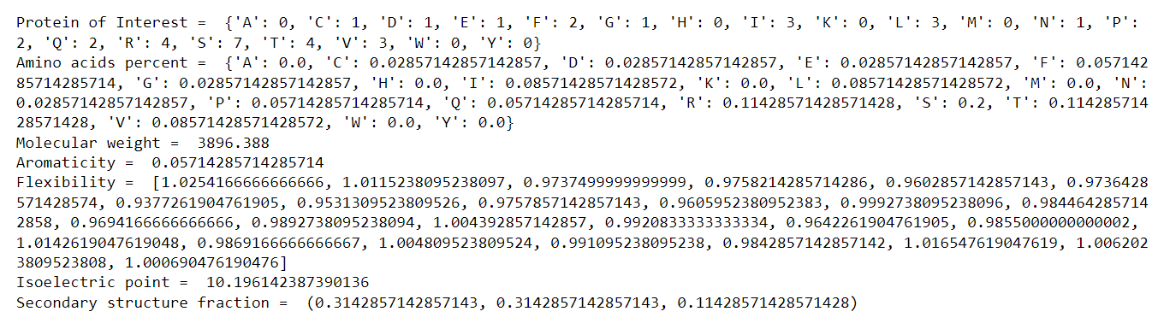
Output:

Slide 13
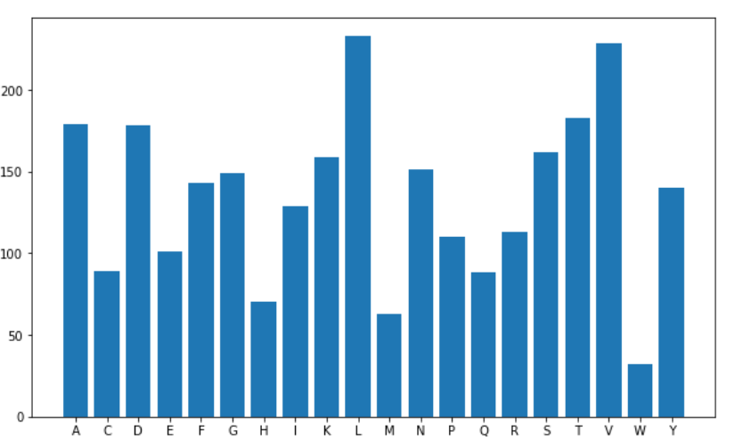
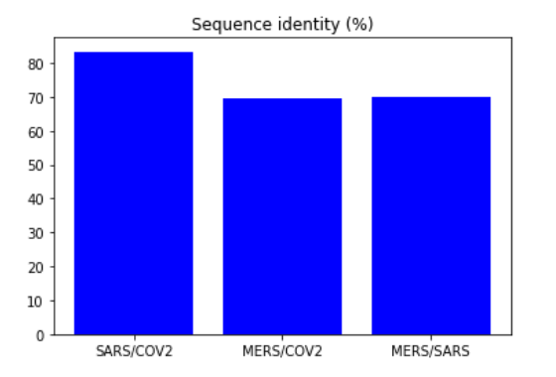
Output:

Slide 14
Conclusion:
Successfully analyzed the similarities between SARS and MERS.
From the Output we got SARS and COV2 has more similarity between them.
MERS to SARS and MERS to COV2 has same range of similarity between them.

